Slide 1
What is TRiO?
Scott Robertson, Director
Student Support Services
WVU Tech
Notes:
Insert the program you will be speaking about and your information.

Slide 2
TRiO History:
Economic Opportunity Act of 1964 yielded the Upward Bound program as a response to the Administration’s War on Poverty.
Higher Education Act of 1965: created the second outreach program, Talent Search.
Higher Education Amendments of 1968 created the third in a series of educational opportunity programs. Originally named the Special Services for Disadvantaged Students, this program title was then changed to Student Support Services.
By the late 1960’s the term “TRiO” was developed to describe these federal programs.

Slide 3
TRiO History:
Higher Education Amendments of 1972 established the fourth TRIO Program, Educational Opportunity Centers.
Veterans Upward Bound established in 1972 as well.
1986 Amendments added the sixth program, the Ronald E. McNair Post-Baccalaureate Achievement Program.
In 1990, the Department of Education created the
Upward Bound Math/Science Program to address the
need for specific instruction in the fields of math and
science.

Slide 4
What is Educational Talent Search?
Notes:
Insert the program you will be speaking about and your information.

Slide 5
Educational Talent Search
Serves middle and high school students
Connections to high quality academic tutoring services, to enable students to complete secondary or postsecondary courses
Advice and assistance in secondary course selection and, if applicable, initial postsecondary course selection
Assistance in preparing for college entrance examinations and completing college admission applications
Connections to education or counseling services designed to improve the financial literacy and economic literacy of students or the students’ parents, including financial planning for postsecondary education.

Slide 6
Educational Talent Search
Information on the full range of Federal student financial aid programs and benefits (including Federal Pell Grant awards and loan forgiveness) and resources for locating public and private scholarships
Assistance in completing financial aid applications, including the Free Application for Federal Student Aid

Slide 7
Educational Talent Search
Any project assisted under this section may provide services such as—
Academic tutoring, which may include instruction in reading, writing, study skills, mathematics, science, and other subjects
Personal and career counseling or activities
Information and activities designed to acquaint youth with the range of career options

Slide 8
Educational Talent Search
Exposure to the campuses of institutions of higher education, as well as cultural events, academic programs, and other sites or activities not usually available to disadvantaged youth
Workshops and counseling for families of students
served
Mentoring programs involving elementary or secondary school teachers or counselors, faculty members at institutions of higher education, students, or any combination of such persons

Slide 9
What is Upward Bound?
Notes:
Insert the program you will be speaking about and your information.

Slide 10
The purpose is to generate in program participants the skills and motivation necessary to complete a program of secondary education and to enter and succeed in a program of postsecondary education.

Slide 11
Eligibility
Who is eligible?
High School Students
From low-income households
From families in which neither parent hold’s a Bachelor’s Degree
Students with disabilities
Homeless children and youth
Students in foster care

Slide 12
Program Description
Intensive six week summer program
MUST provide instruction in math, laboratory science, composition, literature and foreign language.
Students live on campus
Exposure to cultural
Opportunity to take part in work-study program
Monthly meetings with Counselor during academic year
Improve the financial and economic literacy of students
Assistance completing the FAFSA and locating scholarships

Slide 13
Services Provided
Other Potential Services
Peer Tutoring Program
Community service opportunities
College Summit Workshop
Work study
Jump Start Program
Smart Spending
College Transition Class
Summer Wellness Program
Mentor Program

Slide 14
What is Upward Bound Math Science?
Notes:
Insert the program you will be speaking about and your information.

Slide 15
Eligibility
Who is eligible?
High School Students
From low-income households
From families in which neither parent hold’s a Bachelor’s Degree
Students with disabilities
Homeless children and youth
Students in foster care

Slide 16
Program Description
Intensive summer program focused on science and math training.
Year-round counseling and advisement
Exposure to university research faculty
Participant conducted scientific research
Education and Counseling services designed to improve financial and economic literacy

Slide 17
Services Provided
Other Potential Services
Exposure to academic programs and cultural events
Instruction in reading, writing, study skills, and other subjects necessary for success in education beyond high school
Academic, financial, or personal counseling
Tutorial services
Mentoring programs
Information on postsecondary education opportunities
Assistance in completing college entrance and financial aid applications
Assistance in preparing for college entrance exams

Slide 18
What is SSS?
Notes:
Insert the program you will be speaking about and your information.

Slide 19
Eligibility
Who is eligible?
College Students
From low-income households
From families in which neither parent hold’s a Bachelor’s Degree
Students with disabilities

Slide 20
All SSS projects MUST provide:
Academic tutoring, which may include instruction in reading, writing, study skills, mathematics, science, and other subjects
Advice and assistance in postsecondary course selection
Assistance for students with information on the full range of student financial aid programs including benefits and resources for locating public and private scholarships
Education or counseling services designed to improve the financial and economic literacy
Assist students in applying for admission to graduate and professional programs

Slide 21
SSS Projects May also:
Provide individualized counseling for personal, career, and academic information
Complete activities and instruction designed to acquaint students with career options
Exposure to cultural events and academic programs not usually available
Mentoring programs
Secure temporary housing during breaks for students who are homeless youths and students who are in foster care or are aging of the foster care system.

Slide 22
What is McNair ?
Notes:
Insert the program you will be speaking about and your information.

Slide 23
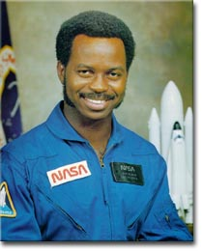
McNair Scholars Program
Born 1950; died Jan. 28, 1986
B.S. in Physics from North Carolina A&T State University; Ph.D. in Physics from MIT
2nd African-American to fly in space

Slide 24
Program Mission:
To prepare first-generation, income-eligible and other underrepresented groups for doctoral study.

Slide 25
Eligibility requirements:
First-generation and income-eligible OR
a member of an underrepresented group: African
American, Hispanic American, Native American, or
Native Hawaiian/Pacific Islander
Will have completed sophomore year by summer
Have a CGPA of 3.0 or higher
US citizens or permanent residents
Have a desire to pursue a terminal graduate degree

Slide 26
Benefits:
$2,400 in stipends for participation
Graduate school and GRE preparation
Research opportunity
Free conference travel and campus visits
Application fee waiver and GRE waiver
Cultural activities
Chance of publication
Tutoring

Slide 27
What McNair Scholars do:
Participate in a 6-week summer research internship
(which includes seminars on research training, GRE
and graduate school preparation, campus visits, and
cultural trips)
Participate in year-round graduate school preparation seminars and also research classes
Conduct a research project under the guidance of a faculty
Present research at a national McNair conference

Slide 28
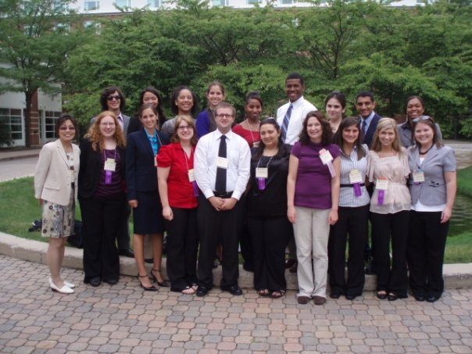
Attendance at McNair Conference:

Slide 29
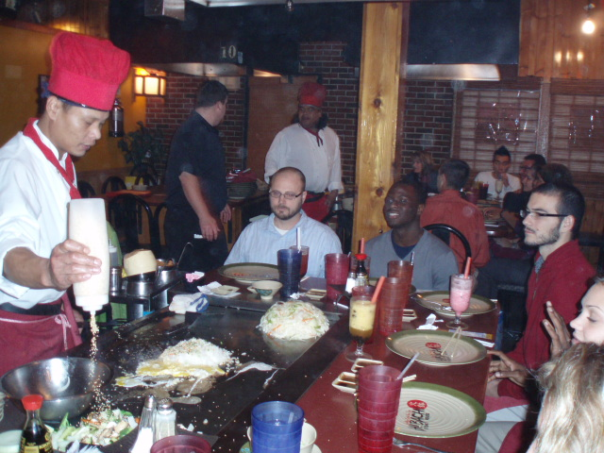
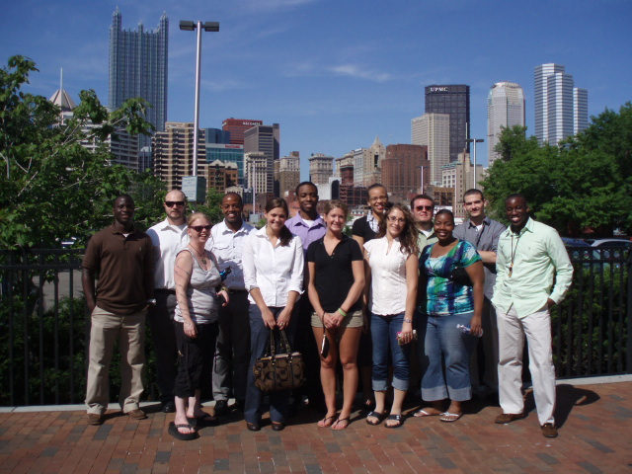
Cultural Activities

Slide 30
What are Educational Opportunity Centers?

Slide 31
Eligibility for Services
Citizen of the United States
At least 19 years of age
Expresses a desire to enroll or is enrolled in a program of postsecondary education and requests information or assistance in applying for admission to, or financial aid for, such a program
A veteran regardless of age

Slide 32
Program Description
Provides counseling and information on college admissions to qualified adults who want to enter or continue a program of postsecondary education.
Provides services to improve the financial and economic literacy of participants.
The goal of the EOC program is to increase the number of adult participants who enroll in postsecondary education institutions.

Slide 33
Services Provided May Include:
Academic Advice
Personal Counseling
Career Workshops
Information on PSE Opportunities and student financial assistance
College Admissions
Tutoring
Mentoring
Education services to improve the financial and economic literacy of participants

Slide 34
What is Veterans Upward Bound?

Slide 35
Program Description
Designed to motivate and assist veterans in the development of academic and other skills necessary for acceptance and success in PSE
Provide assessment and enrichment through counseling, mentoring tutoring and academic instruction in core subject areas.
Must provide instruction in mathematics through pre-calculus, lab sciences, foreign languages and literature
Programs can provide short term remedial or refresher courses.
Assist vets with securing support services from local resources such as the VA, state veteran agencies and other organizations that serve vets.

Slide 36
Additional Services
Education or counseling services designed to improve the financial and economic literacy of participants
Instruction in reading, writing, study skills, and other subjects necessary for success in education beyond high school
Academic, financial, or personal counseling
Tutorial services
Mentoring programs
Information on postsecondary education opportunities
Assistance in completing college entrance and financial aid applications
Assistance in preparing for college entrance exams
Information on the full range of Federal Student financial aid programs and benefits
Guidance and assistance in alternative education programs for secondary school dropouts that lead to receipt of a regular secondary school diploma, entry into general education development (GED) programs or postsecondary education

Slide 37
Potential Partnerships

Slide 38
WVU Upward Bound
Partner with Housing and Adventure WV for van usage
Rent vans for $50 for Saturday Sessions
Partner with Adventure WV for Challenge Course as part of a Saturday Session
Adventure WV students do this as part of their “final exam”
Free

Slide 39
Shepherd University
Student Support Services
Presentations to incoming freshman on first year college experiences and expectations.

Slide 40
WVU McNair
Partner with Office of Graduate Education and Life and ASPIRE office to host GRE Boot Camp
Participate in Career Fairs held by Career Services
Host poster contest showcasing research and judge by university officials
Partner with Office of Service for community service opportunities

Slide 41
WVU Tech
Student Support Services
Partner with Office of Student Life for dinner theater and performance by the Charleston Light Opera Guild.
Speak at Orientation to students and parents about program services

Slide 42
Questions?
Scott Robertson, Director
WVU Institute of Technology
Phone: 304-442-3223
E-mail: sdrobertson@mail.wvu.edu

